Slide 1
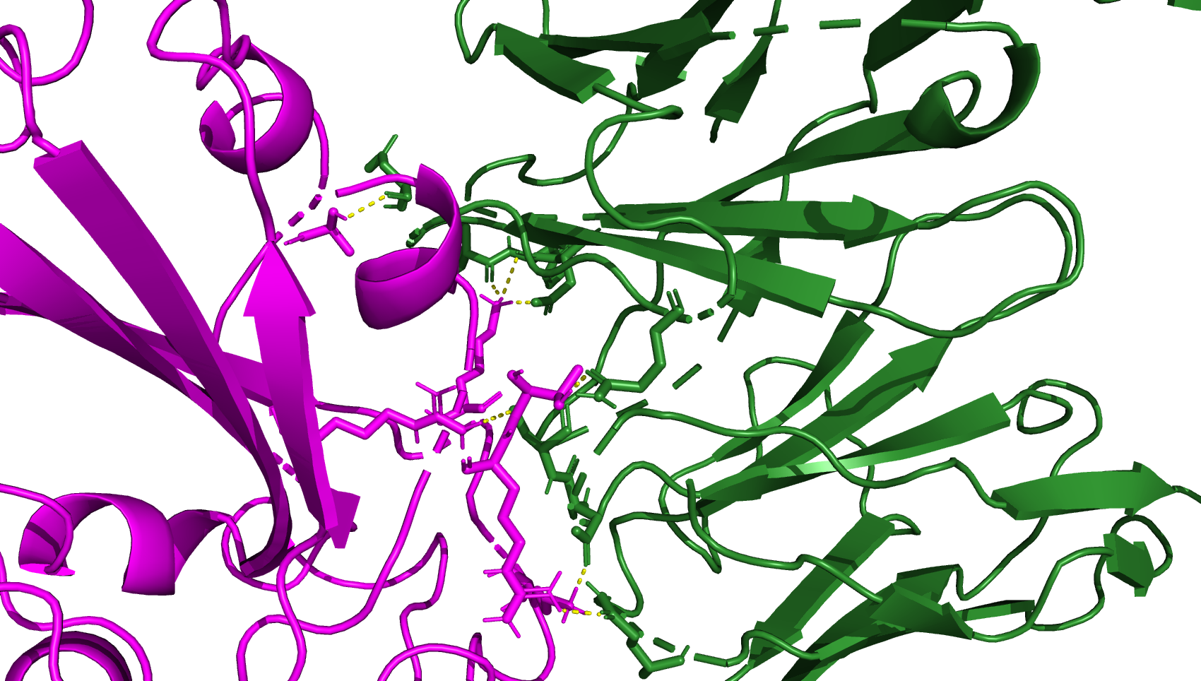
8dw9_BA286, the page after is JN.1 from 8dw9
A372
K440
T345
R508
K444
R346
(A)

Slide 2
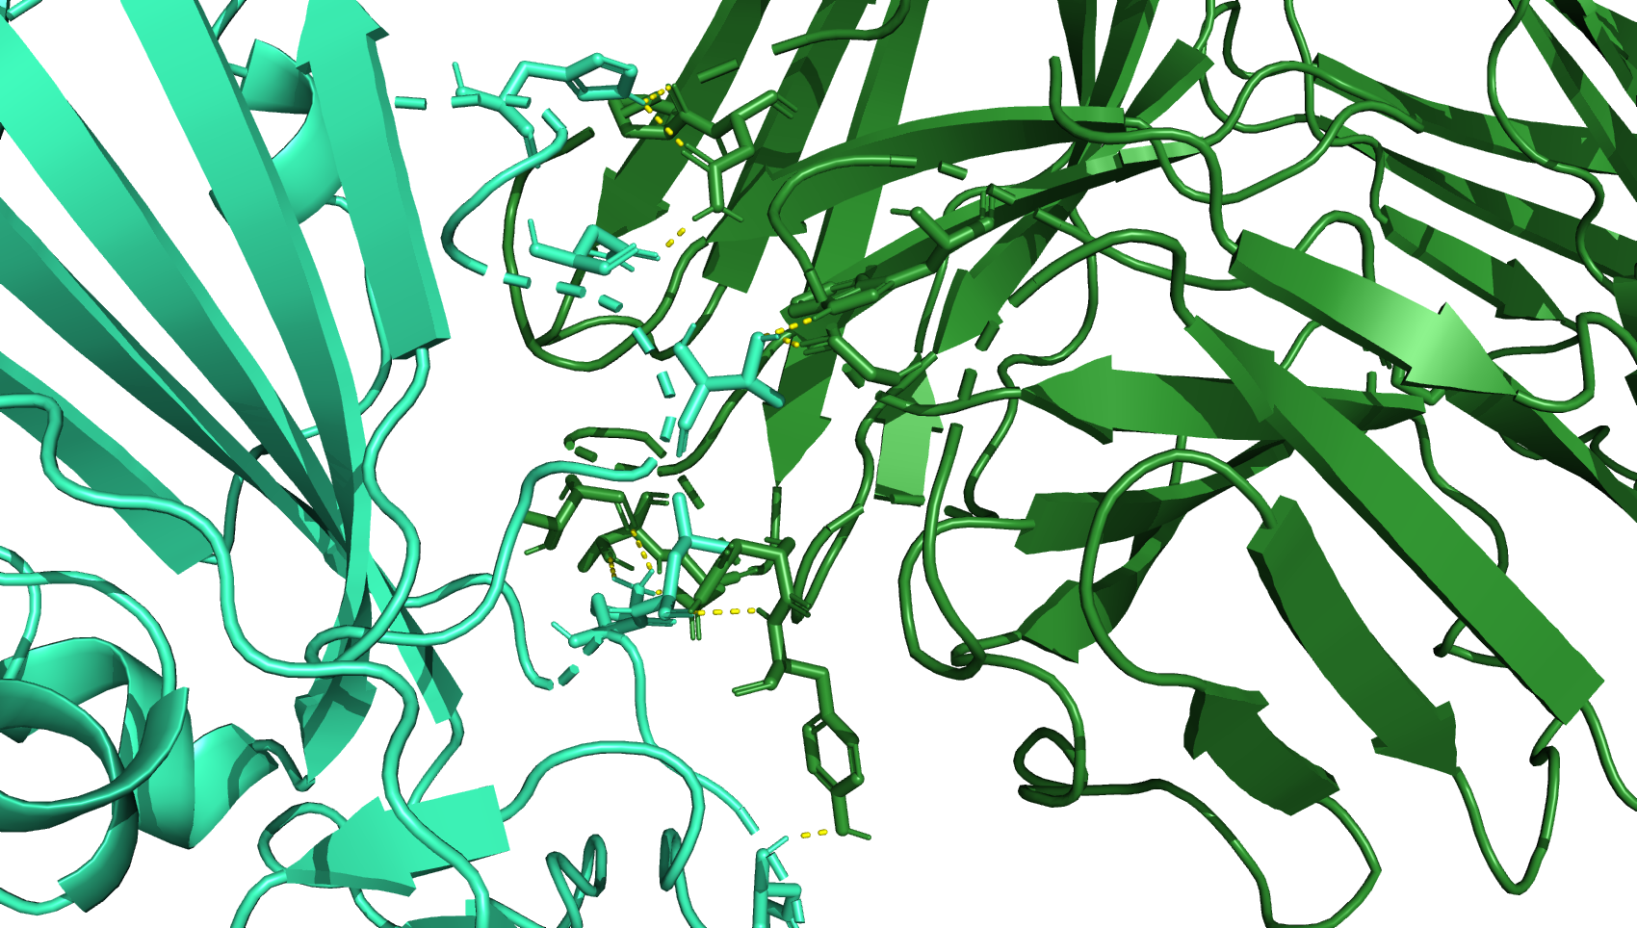
H339
N343
T345
K440
L441
H445
(B)

Slide 3
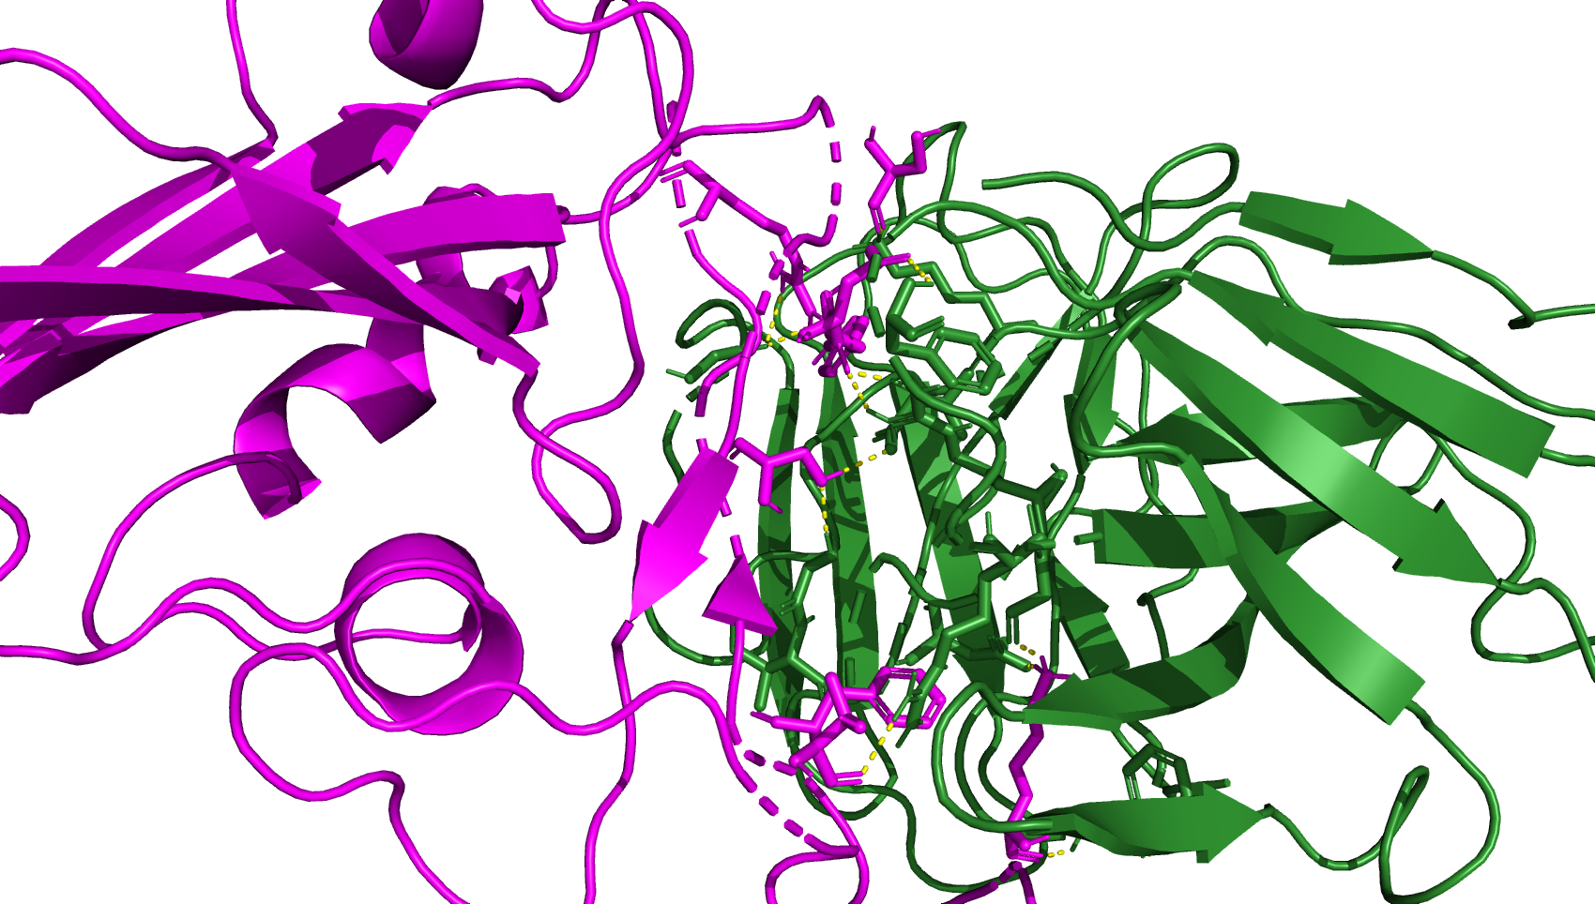
7xd2 BA286 and Jn.1 is after this for 7xd2
R497
S446
D450
Y449
S493
F489
K483
T470
(C)

Slide 4
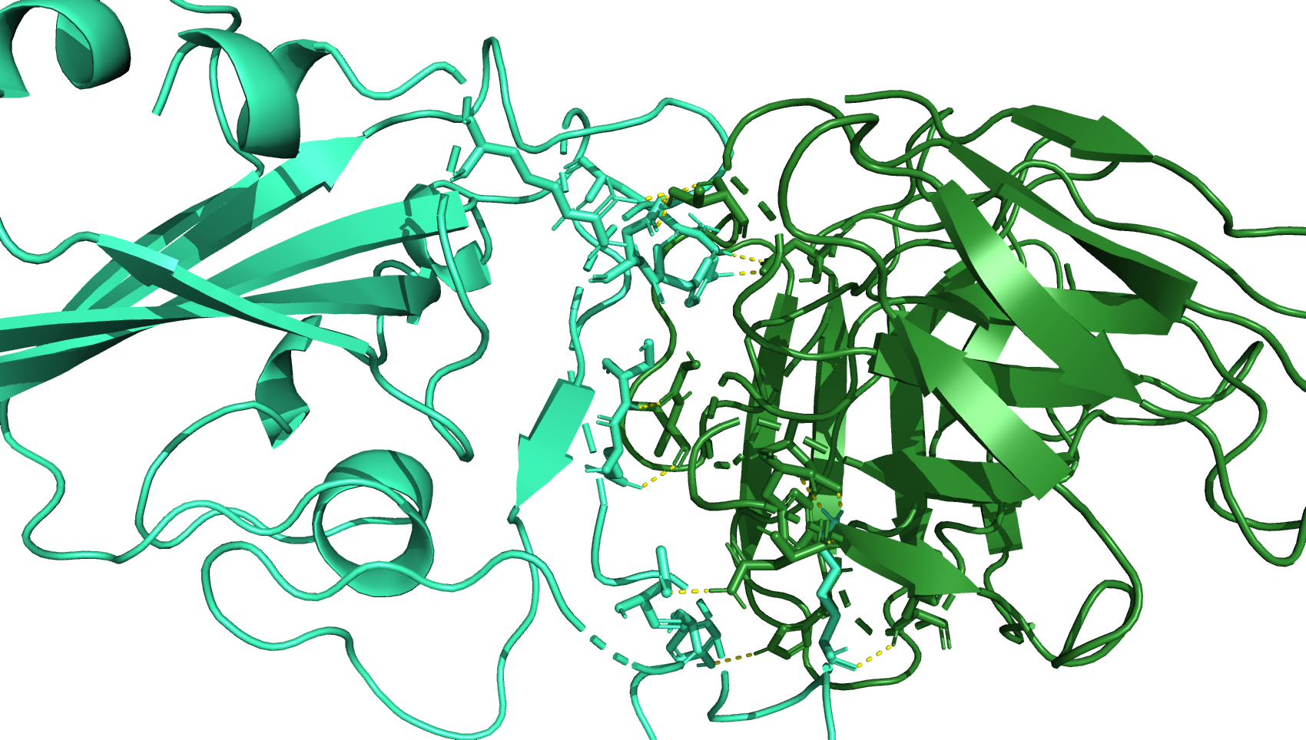
D450
R346
R497
Y449
S493
Q492
K483
T470
Y488
(D)

Slide 6
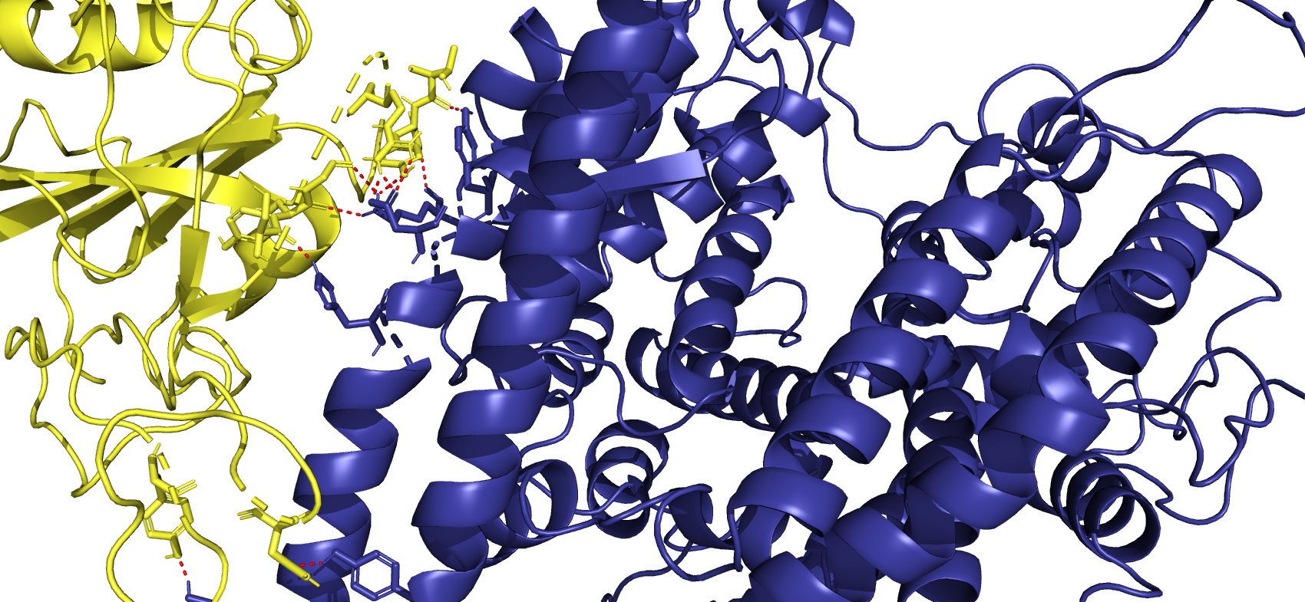
ACE2 XBB.1.5 7xo9 XBB.1.5, JN.1 is after this
T500
G502
G496
R498
Y495
Y501
S494
N487
Y473

